Slide 1
Arogya AI – Agentic Disease Prediction with Ayurvedic Recommendations By:Rohit(23BCE0052) Anshika(23BCE0080)

Slide 2
Agenda
Abstract
Problem Statement
Proposed Work
System Architecture
Workflow
Models and Technologies Used
Scalability & Reliability
Scope & Future Enhancements
References

Slide 3
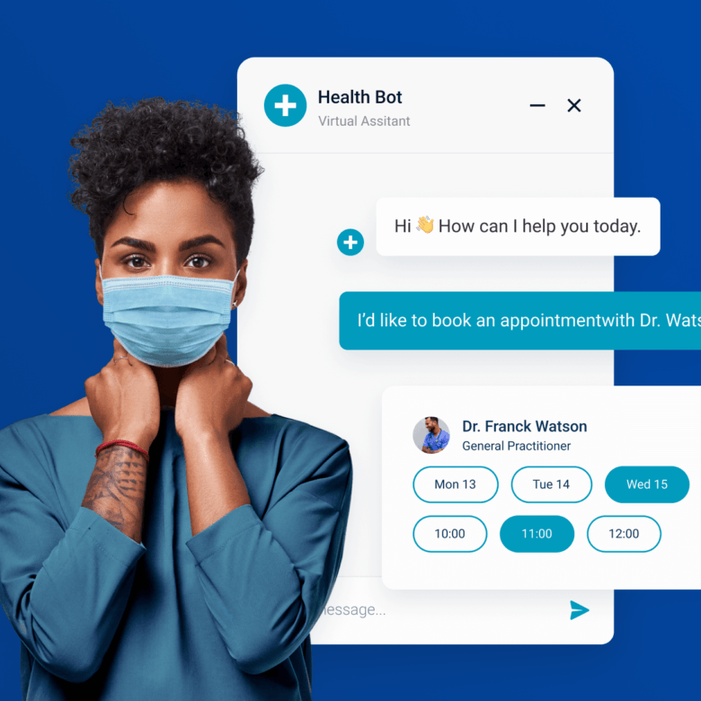
Abstract
Innovative Early-Stage Disease Prediction Framework: Intelligent early-stage disease prediction employs sophisticated algorithms to detect potential health issues at nascent stages, enabling timely interventions. Agentic AI + reasoning agents: Incorporates intelligent agents that proactively engage in decision-making processes based on real-time data and context.
Mapping to Ayurvedic remedies: Utilises a comprehensive database of Ayurvedic treatments to suggest personalised remedies based on predicted conditions. Scalable cloud deployment and secure data handling: Leveraging cloud infrastructure for flexibility and security, ensuring user data is processed and stored safely while fulfilling demand.

Slide 4
Problem Statement
The current diagnostic landscape lacks efficient tools capable of predicting diseases in their formative stages, delaying intervention. Weave relatable stories into your presentation using narratives that make your message memorable and impactful
As healthcare demand surges, there is a dire need for AI systems that can scale efficiently to meet patient needs without compromising quality. Use live polls or surveys to gather audience opinions, promoting engagement and making sure the audience feels involved
Healthcare solutions must provide transparent reasoning behind predictions to foster trust among users and healthcare professionals.
Patients and providers alike seek comprehensive solutions that not only diagnose but also prevent conditions through lifestyle and dietary recommendations.

Slide 5
Proposed Work
Multinomial Naive Bayes prediction engine: utilises probability-based predictions to determine disease likelihood based on symptomatology, allowing for a data-driven approach to diagnostics.
Agentic reasoning & hypothesis locking: Incorporates advanced reasoning techniques to validate predictions and ensure coherent recommendations based on established hypotheses.
Ayurvedic knowledge-base integration: Enriches our predictive model with culturally relevant Ayurvedic insights, ensuring recommendations resonate with users’ backgrounds.
Cloud-native deployment & secure storage: Ensures efficient deployment of services while emphasising data security through encrypted storage and regulated access.

Slide 6
System Architecture
Web/App UI → Cloud API → ML microservice: End-users interact via a web or mobile interface that communicates with our cloud-based API to trigger processing within our ML pipelines.
Rule-based agent layer: A sophisticated rule-based layer that translates user interactions into actionable insights, guiding the prediction workflow.
Cloud database (symptom-disease, Ayurveda CSV): A structured repository of symptom-disease mappings alongside Ayurvedic treatment references to facilitate accurate recommendation generation.
LLM API for explanations: Employs a Large Language Model API to generate human-readable explanations for predictions, enhancing user understanding and trust.
Final response delivery: The system efficiently consolidates predictions and recommendations to deliver a cohesive response to the user through the frontend interface.

Slide 7
Workflow
Users start by inputting their symptoms into the system through the user-friendly interface, ensuring accessibility.
Symptom inputs are efficiently routed through the system architecture for analysis and prediction validation, optimising processing time.
The system generates initial predictions based on symptom data using our advanced ML models, providing immediate feedback.
Provisional predictions are evaluated and validated by the agent layer, ensuring recommendations are consistent and reliable.
Artificial intelligence maps identified conditions to relevant Ayurvedic treatments, suggesting holistic approaches for management.
Employs advanced language models to convert complex predictions into understandable outputs for users.
outcomes, along with tailored Ayurvedic recommendations and explanations, are delivered securely back to the user.

Slide 8
Models and Technologies Used
Multinomial Naive Bayes: Our prediction engine, grounded in basic probability principles, classifies symptoms to identify potential diseases effectively.
Rule-based intelligent agent: This layer employs logical rules to improve decision-making and enhance the reliability of predictions.
RESTful cloud APIs: Utilise standard protocols for seamless interaction between user interfaces and backend services, ensuring versatility and scalability.
Managed DB / Cloud storage: Employs reliable and secure database solutions for efficient data handling and access control.
LLM explanation service: Employs advanced language models to convert complex predictions into understandable outputs for users.
Containerization (Docker): Ensures that our application components are easily deployed and scaled, maintaining consistency across environments.

Slide 9
Scalability & Reliability
Allows our machine learning services to extend horizontally, accommodating growing user demand without sacrificing performance.
Distributes incoming traffic across multiple instances to prevent overload and ensure optimal response times.
Ensures that all service endpoints adhere to strict authentication protocols, safeguarding user data and interactions.
Employ monitoring tools to maintain real-time insight into system performance, detecting anomalies proactively.
Employs comprehensive strategies for data backup and redundancy to ensure system resilience and recovery in case of failure.

Slide 10
Scope & Future Enhancements
Implementing analytics interfaces to deliver insightful data on user health trends and system performance.
Plans to incorporate data from wearable technology to enrich user profiles and improve predictive accuracy.
Future versions may include voice input/output and multi-language support to improve accessibility and user experience.
The system can incorporate severity scoring and visual risk indicators to help users better understand the urgency of their condition.
The system can be connected with telemedicine platforms to enable direct consultation with certified medical professionals when high-risk conditions are detected.

Slide 11
References
S. Khan and M. R. Ghalib, “A Naive-Bayes approach for disease diagnosis with analysis of disease type and symptoms,” Int. J. Appl. Eng. Res., vol. 10, no. 11, pp. 29005–29014, 2015.
H. Patel, D. Sathwara, V. Maheshwari, and D. Joshi, "Harnessing Artificial Intelligence for the Future of Precision Medicine: Transforming Patient-Centric Care Through Data-Driven Innovation," Biopress J. Comput. Life Sci., vol. 1, no. 4, Jul. 2025.
S. R. Thamma, "Agentic AI for Clinical Decision Support: Real-Time Diagnosis, Triage, and Treatment Planning," Int. J. Sci. Res. Sci. Eng. Technol., 2025. doi: 10.32628/IJSRSET251265.
E. H. Shortliffe and M. J. Sepúlveda, "Clinical Decision Support in the Era of Artificial Intelligence," JAMA, vol. 320, no. 21, pp. 2199–2200, 2018. doi: 10.1001/jama.2018.17163.

Slide 12
Thank you
Rohit Shrivastava : 23BCE0052
Anshika Rai : 23BCE0080

